Slide 1
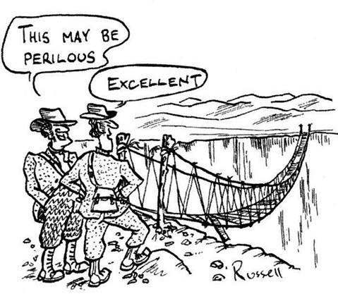
Safety in IES
Module Introduction
Monday 29th September 2003
Victorian Risk Assessment

Slide 2
What we require of Students…
To take reasonable care for the health and safety of themselves and of other persons who may be affected by their acts or omissions.
To co-operate with University staff in fulfilling the statutory requirements placed on the University and to comply with general and specific health and safety requirements set out in associated published documents
Not to intentionally interfere with or misuse anything that has been provided in the interests of health and safety
However – this is not quite enough…!

Slide 3
Why a different emphasis on safety?
Your project is Independent – so you control far more of what you do
Your work will be investigative – so you may be trying out new techniques, measurements or experiments
Your work is not timetabled or directly supervised – so activities may not be seen or may take place away from the University

Slide 4
Why a different emphasis on safety?
Your experience of safety systems up to this point is likely to be varied.
Safe system of work needs to be identified at proposal stage via correct methodology and risk assessment.
This needs to reflect accepted practice and your tutor will need to agree your safety measures
Ongoing project management will mean that control measures will be adapted as activity in the project changes

Slide 5
Some specific issues
Work at height
Manual handling
Use of tools / power tools / machinery
Use of lifting equipment
Display Screen Equipment
Electricity
Noise & Vibration
Hot / cold
Environmental Effects
Violence
COSHH

Slide 6
Lab work
No work on supplies above 50V & polyphase unless suitable protective measures in place
Use of isolation
Use of RCDs
Requirement for shrouded terminals & test leads
Use of GS38 test leads
Use of pillar drill and other tools

Slide 7
Are you competent to proceed?
Are you familiar with UK safety legislation?
Can you identify best practice in the area you intend studying?
Can you identify hazards and minimise risk through suitable and workable control measures?
Can you identify the residual risk and ensure it is acceptable?
Can you document your assessment procedure in a manner which is legally “suitable and sufficient”?

Slide 8
Are you competent to proceed?
If you believe that you are competent, please carry out a Section A initial assessment, then complete Section B. Then let me see it!
If you are not sure, I will take you through the next set of slides…

Slide 9
Risk Assessment
Essential part of UK law
HSAW 1975
Subsequent Regulations
Criminal & civil law
Move from rule based to risk based approach
Legal, financial, business, employer, insurance, & stakeholder implications

Slide 10
Risk Assessment
Is this chemical safe? Discuss…
POTENTIAL HEALTH EFFECTS:
INHALATION:
Short Term Exposure: irritation, irregular heartbeat, headache, symptoms of drunkenness, kidney damage, liver damage
Long Term Exposure: tingling sensation, paralysis
SKIN CONTACT:
Short Term Exposure: irritation, symptoms of drunkenness, kidney damage, liver damage
Long Term Exposure: kidney damage
INGESTION:
Short Term Exposure: vomiting, digestive disorders, headache, symptoms of drunkenness, lung congestion, kidney damage, liver damage

Slide 11
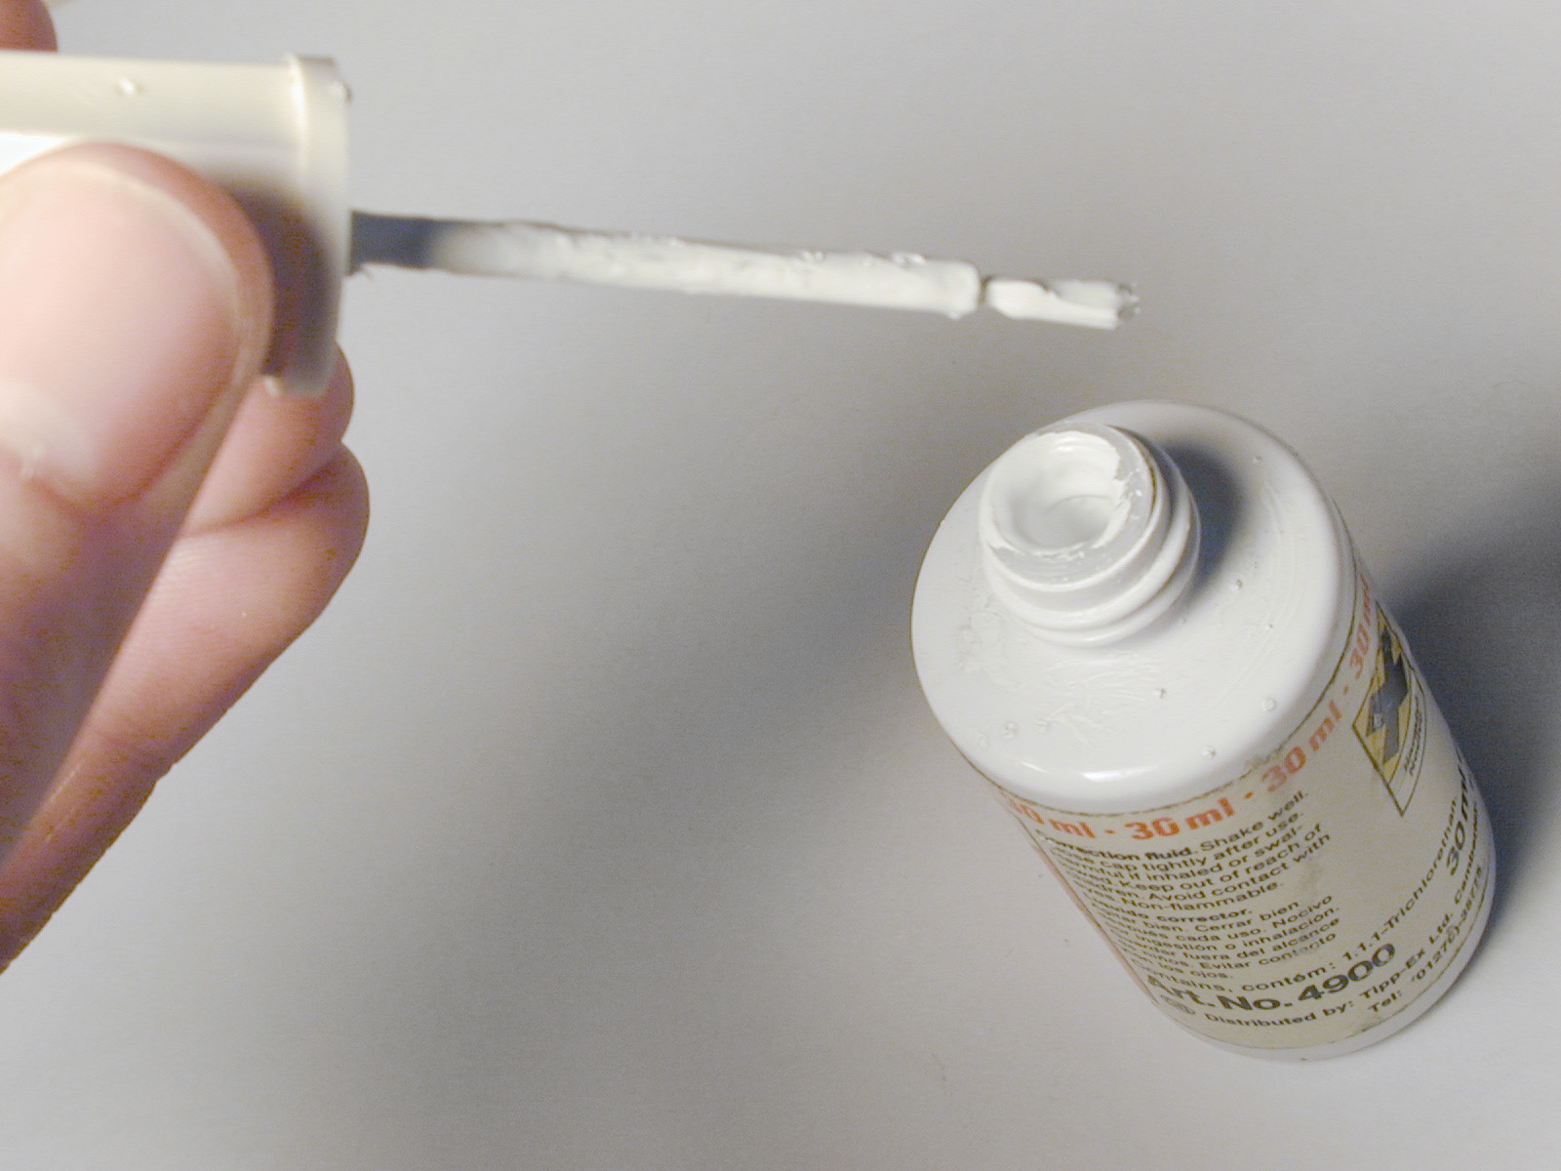
Risk Assessment

Slide 12
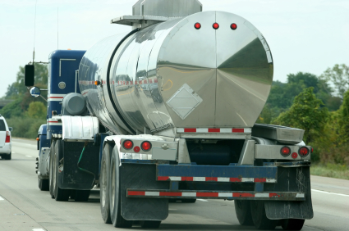
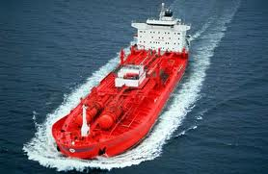
Risk Assessment

Slide 13
Risk Assessment
1,1,1 trichloroethane
Intrinsic properties do not change
Usage, quantity, environment, activity, user knowledge & skill etc. certainly does…

Slide 14
Risk Assessment
What is a Hazard?
the potential of a substance, activity or process to cause harm
What is a Risk?
the likelihood of a substance, activity or process to cause harm

Slide 15
Risk Assessment
An essential part of the planning stage of any H&S management system
Helps you decide priorities and set objectives for eliminating hazards and reducing risks
If risks cannot be eliminated through selection and design of facilities, they should be minimised through use of physical controls, or as a last resort, through systems of work and personal protective equipment (PPE).
This is known as the ‘safety hierarchy’ – and you will be expected to put this into practice.

Slide 16
Legal Aspects of Risk Assessment
General duty under HSAW 1974
Specific duty under management of Health & Safety at Work regulations. It must be:
Suitable & sufficient
Cover both employees, self employed and those affected by your actions
Reviewed as necessary
Recorded (more than 4 employees) and at risk groups identified
Still carried out if less than 4 employees.

Slide 17
Legal Aspects of Risk Assessment
Specific RAs needed for certain regulations:
Ionising Radiations regulations 1999
Control of Asbestos at Work regulations 2002
Control of Noise at Work regulations 2005
Manual Handling Operations regulations 1992
Health & Safety (Display Screen Equipment) regulations 1992
Work at Height regulations 2005
Control of Vibration at Work regulations 2005
Control of Lead at Work regulations 2002
Control of Substances Hazardous to Health regulations 2002

Slide 18
Risk Assessment
What would you do in these situations…

Slide 19
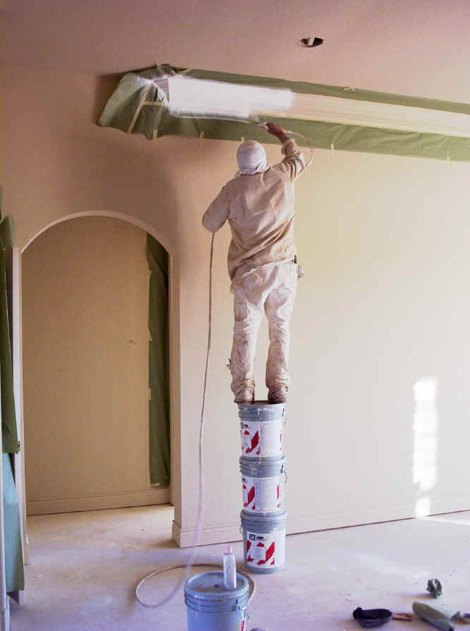

Slide 20
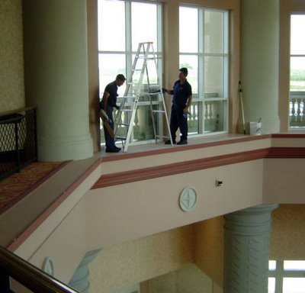

Slide 21
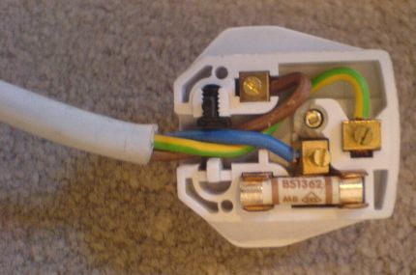

Slide 22
Risk Assessment
Do I really need a Risk Assessment for IEP?…
Legal obligation
Tutor responsibility
Stakeholders & public
Subject to legal scrutiny
Business practice

Slide 23
Risk Assessment
Do I really need a Risk Assessment for IEP?…
Measurement of sound levels at a night club
Building a switch mode power supply
Microprocessor controlled pyrotechnic detonator
Measurement of noise exposure of volunteers
Trackside noise measurement of freight wagons

Slide 24
How can I carry out a Risk Assessment?
STEP 1: Look for the hazards
STEP 2: Decide who might be harmed and how
STEP 3: Evaluate the risks and decide whether the existing precautions are adequate or whether more should be done
STEP 4: Record your findings
STEP 5: Review your assessment and revise it if necessary

Slide 25
How can I carry out a Risk Assessment?
When controlling risks apply the principles below, using them in the order shown:
Elimination
Substitution
Engineered controls
Administrative controls
Personal protective equipment

Slide 26
How can I carry out a Risk Assessment?
Elimination
Eliminating the hazard - physically removing it - is the most effective hazard control.
For example, if you must work high above the ground, the hazard can be eliminated by moving the piece you are working on to ground level to eliminate the need to work at heights.

Slide 27
How can I carry out a Risk Assessment?
Substitution
Substitution, the second most effective hazard control, involves replacing something that produces a hazard (similar to elimination) with something that does not produce a hazard—for example, replacing lead based paint with acrylic paint.
To be an effective control, the new product must not produce another hazard.

Slide 28
How can I carry out a Risk Assessment?
Engineered controls
The third most effective means of controlling hazards is engineered controls.
These do not eliminate hazards, but rather isolate people from hazards.
For example, the hazards arising from measuring current and voltage on a three phase motor system could be reduced by use of a suitable enclosure and providing shrouded test terminals

Slide 29
How can I carry out a Risk Assessment?
Administrative controls
Administrative controls are changes to the way people work and could include procedure changes, employee training, and installation of signs and warning labels.
Administrative controls do not remove hazards, but limit or prevent people's exposure to the hazards, such as only allowing access to a machine when supervision is available.

Slide 30
How can I carry out a Risk Assessment?
Personal protective equipment
Personal protective equipment (PPE) includes gloves, respirators, hard hats, safety glasses, high-visibility clothing, and safety footwear.
PPE is the least effective means of controlling hazards because of the high potential for damage to render PPE ineffective.
Also, use of some PPE can introduce additional hazards!

Slide 31
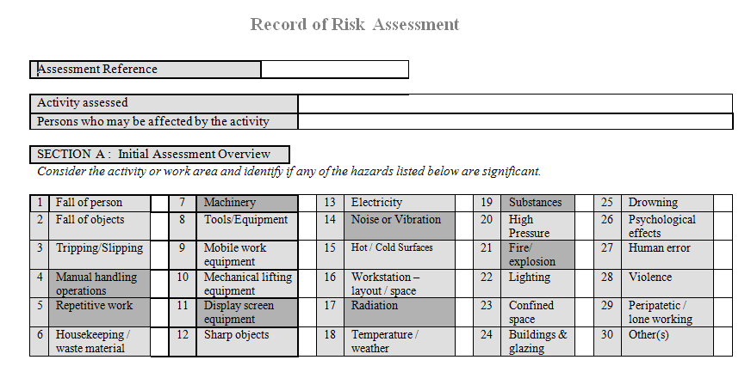
How do I use the University Risk Assessment form?
Look at the categories in section A. These should help you identify any hazards in your proposed project work. Tick the ones that apply.

Slide 32
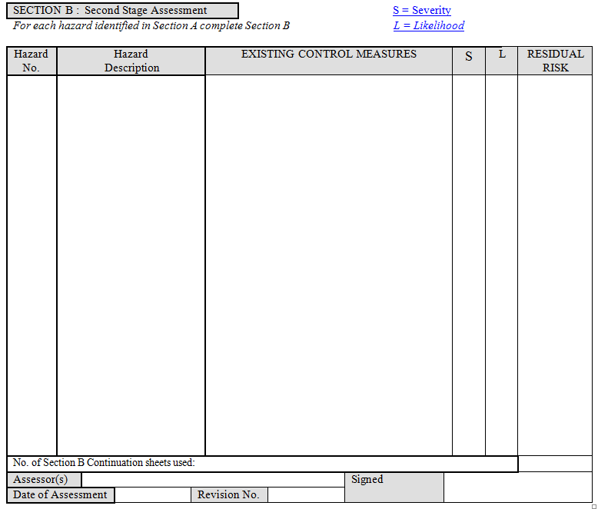
How do I use the University Risk Assessment form?
For each hazard you’ve ticked, think about how the risk is reduced – what would be your normal way of working? Write it down in Section B. This is your existing control measure.

Slide 33
How do I use the University Risk Assessment form?
Now look at the Risk Evaluation Matrix and decide how likely it is that the hazard will cause harm and how severe the harm would be.
The matrix will give you an assessment of remaining risk.
Write down the residual risk (worked out from the matrix) in the last column of Section B.

Slide 34
How do I use the University Risk Assessment form?
For example: working with mains voltage presents a hazard. It could lead to major injury or fatality (severity).
If you had intended working on a live machine with exposed terminals and no special measures were in place then the likelihood of major injury or fatality would be high.
The matrix would show your residual risk was moderate, substantial or intolerable and you would have to improve control measures (moderate risk) suspend work (substantial risk) or immediately stop the work (intolerable risk).

Slide 35
How do I use the University Risk Assessment form?
To improve the situation with the machine, we would most likely ensure that suitable enclosures were in place, that live parts could not be touched, measurement points were made via shrouded terminals and test leads and that the mains supply was either isolated (1:1 transformer) or fitted with an appropriate residual current device (RCD).
If we now re-evaluate our activity, the hazard (mains electricity) and its severity stays the same but the likelihood of receiving a shock is now very low – so the residual risk can be recorded as “trivial”.

Slide 36
How do I use the University Risk Assessment form?
If your activities show a residual risk that’s “trivial” or “tolerable” your control measure is acceptable and your assessment of that hazard and its risk is complete for now.
For any residual risk that is “moderate” or higher you must look at the activity again and determine how you will make it safer.
The risk assessment you submit with your proposal should show only “trivial” or “tolerable” remaining risk.
If you introduce any new activities during your project or change existing ones, you should re-evaluate your control measures.

Slide 37
Risk Evaluation Matrix:
Severity
1 - Minor injury
2 - First Aid
3 - Major injury or lost time
4 - Fatality
Likelihood
Tolerable
Risk
Substantial
Risk
4 - Highly likely
Moderate
Risk
Intolerable
Risk
3 - Probable
Tolerable
Risk
Tolerable
Risk
Substantial
Risk
Substantial
Risk
Moderate
Risk
Tolerable
Risk
Tolerable
Risk
Tolerable
Risk
2 - Possible
Moderate
Risk
Moderate
Risk
Tolerable
Risk
Tolerable
Risk
1 - Improbable
Trivial
Risk
Trivial
Risk

Slide 38
Risk Evaluation Matrix:
Intolerable
Risk
Activity should be suspended immediately until action is taken to reduce the risk
Substantial
Risk
Significantly high risk that where reasonably practical activity should be suspended until significant action has been taken to reduce the risk. Where this is not reasonably practicable, strict deadlines should be agreed for further action to reduce the risk.
Moderate
Risk
Significant action should be planned in accordance with overall risk management program to reduce the risk.
Tolerable
Risk
Risk level is acceptable as long as all reasonably practicable controls are in place.
Trivial
Risk
Risk level is low no significant action required.

Slide 39
Risk Assessment Form
A copy of the form is available on the IES webpage

Slide 40
Risk Assessment Form

Slide 41
Getting Help
The HSE can provide a range of practical guidance.
http://www.hse.gov.uk/risk/casestudies/index.htm
http://www.hse.gov.uk/risk/fivesteps.htm
Any queries? Please see your project or module leader. Technical advice is available from the technician team.
If you are in doubt – ask first before carrying out any activity.
Simon Lewis – September 2014

